Slide 1
Lecture-11
File Processing

Slide 2
We’ll Learn Today
Introduction
The Data Hierarchy
Files and Streams
Character I/O
String I/O
Formatted I/O
Record I/O

Slide 3
Introduction
Data files
  Can be created, updated, and processed by C programs
  Are used for permanent storage of large amounts of data
    Storage of data in variables and arrays is only temporary

Slide 4
The Data Hierarchy
Data Hierarchy:
  Bit – smallest data item
    Value of 0 or 1
  Byte – 8 bits
    Used to store a character
      Decimal digits, letters, and special symbols
  Field – group of characters conveying meaning
    Example: your name
  Record – group of related fields
    Represented by a struct or a class
    Example: In a payroll system, a record for a particular employee that contained his/her identification number, name, address, etc.

Slide 5
The Data Hierarchy (Cont’d)
Data Hierarchy (continued):
  File – group of related records
    Example: payroll file
  Database – group of related files

Slide 6
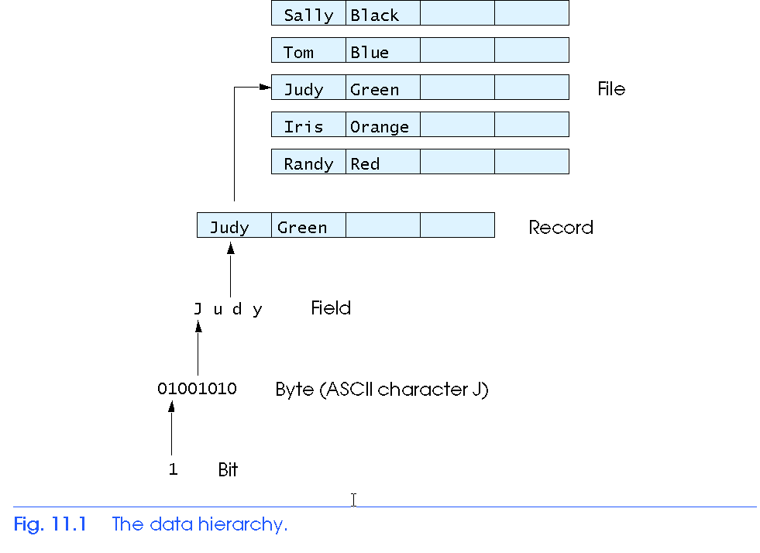
The Data Hierarchy (Cont’d)

Slide 7
The Data Hierarchy (Cont’d)
Data files
  Record key
    Identifies a record to facilitate the retrieval of specific records from a file
  Sequential file
    Records typically sorted by key

Slide 8
Files and Streams
C views each file as a sequence of bytes
  File ends with the end-of-file marker
    Or, file ends at a specified byte
Stream created when a file is opened
  Provide communication channel between files and programs
  Opening a file returns a pointer to a FILE structure
    Example file pointers:
    stdin - standard input (keyboard)
    stdout - standard output (screen)
    stderr - standard error (screen)

Slide 9
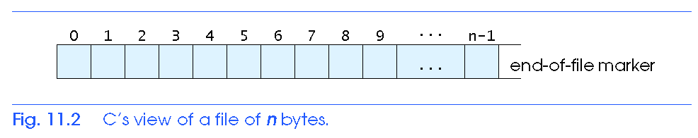
Files and Streams (Cont’d)
FILE structure
  File descriptor
    Index into operating system array called the open file table
  File Control Block (FCB)
    Found in every array element, system uses it to administer the file

Slide 10
Files and Streams (Cont’d)
Read/Write functions in standard library
  fgetc
    Reads one character from a file
    Takes a FILE pointer as an argument
    fgetc( stdin ) equivalent to getchar()
  fputc
    Writes one character to a file
    Takes a FILE pointer and a character to write as an argument
    fputc( 'a', stdout ) equivalent to putchar( 'a' )
  fgets
    Reads a line from a file
  fputs
    Writes a line to a file
  fscanf / fprintf
    File processing equivalents of scanf and printf

Slide 11
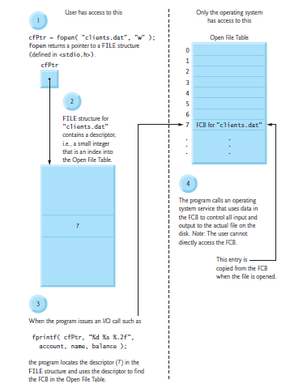


Slide 12
Buffer Memory
Reading and writing to and from the files stored in the disk is relatively slow process when compared to reading and writing data stored in the RAM. As a result, all standard input/output functions uses something called buffer memory to store the data temporarily.
The buffer memory is a memory where data is temporarily stored before it is written to the file. When the buffer memory is full the data is written(flushed) to the file.

Slide 13
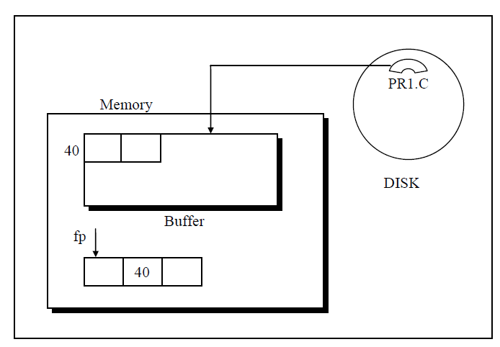

Slide 14
Opening a File
Before any i/o (short of input/output) can be performed on a file you must open the file first. fopen() function is used to open a file.
Syntax:
FILE *fopen(const char *filename, const char *mode);
filename: string containing the name of the file.
mode: It specifies what you want to do with the file i.e read, write, append.
On Success fopen() function returns a pointer to the structure of type FILE. FILE structure is defined in stdio.h and contains information about the file like name, size, buffer size, current position, end of file etc.
On error fopen() function returns NULL.

Slide 15
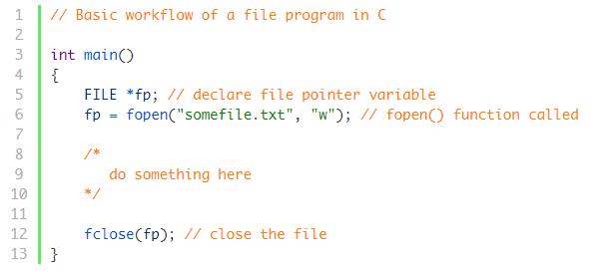
Basic workflow of a file program in C

Slide 16
Character, String, Formatted, and Record I/O
The standard I/O package makes available four different ways of reading and writing data.
  Character I/O
  String I/O
  Formatted I/O
  Record I/O

Slide 17
Character I/O
void main(void)
{
FILE *fp;
char ch;
fp=fopen(“Myfile.txt”, “w”);
if(fp==NULL)
{
printf(“\n Unable to Open!”);
exit(0);
}
while( (ch=getche()) ! = ‘ \r ’ )
putc( ch, fp );
fclose(fp);
}

Slide 18
Explanation
C imposes no file structure
  No notion of records in a file
  Programmer must provide file structure
Creating a File
  FILE *fP;
    Creates a FILE pointer called cfPtr
  fP = fopen(“Myfile.txt", “w”);
    Function fopen returns a FILE pointer to file specified
    Takes two arguments – file to open and file open mode
    If open fails, NULL returned

Slide 19
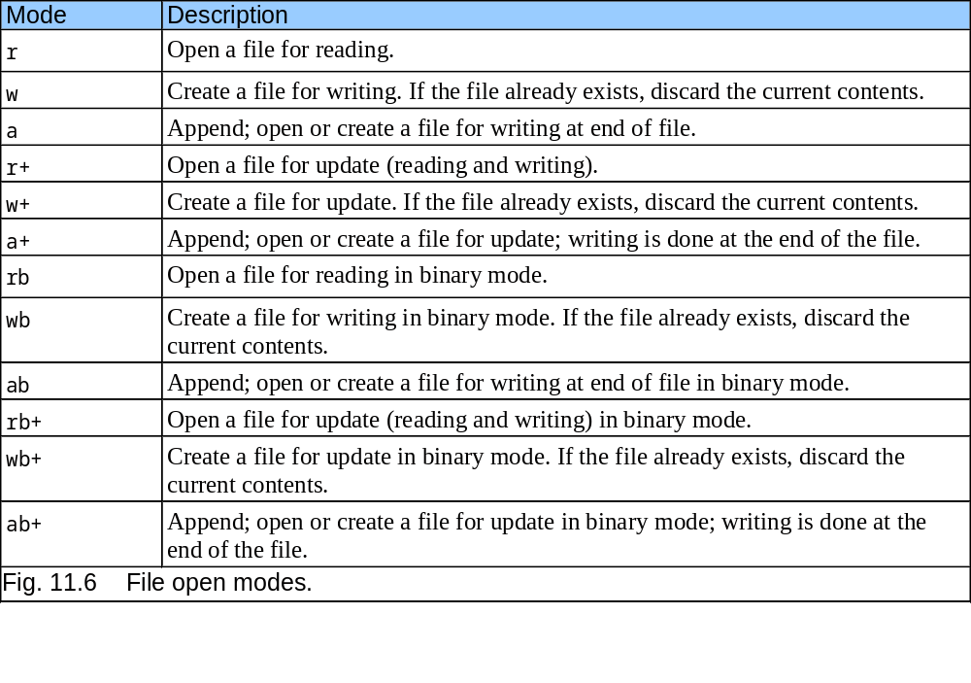
File Open Modes

Slide 20
Example
void main(void)
{ FILE *fp1, *fp2;
char ch;
fp1=fopen( “Myfile.txt”, “r” );
if( fp == NULL)
{
printf(“\nUnable to Open”);
exit(0);
}
fp2=fopen( “abc.txt” , “w”);
while( (ch=getc(fp1)) != EOF)
putc( ch , fp2 );
fclose(fp1); fclose(fp2);
}

Slide 21
Printer Output
void main(void)
{ FILE *fp;
char ch;
fp = fopen(“MyFile.txt”, “r” );
if ( fp == NULL )
{
printf(“\nUnable to Open!”);
exit(0);
}
while ( (ch=getc(fp)) != EOF )
putc ( ch, stdprn);
fclose(fp);
}

Slide 22
String I/O
void main(void)
{
FILE *fp;
char ch[80];
fp = fopen( “ TextFile.txt “, “w” );
if ( fp == NULL )
{
printf(“\n Unable to Open”);
exit(0);
}
do
{
clrscr();
printf(“ Enter Any String:\n”);
gets(ch);
fputs( ch , fp );
fputs(“\n”, fp);
} while( strlen(ch) ! = 0 );
fclose(fp);
}

Slide 23
String I/O (Cont’d)
void main(void)
{
FILE *fp;
char ch[80];
fp = fopen( “ TextFile.txt “, “r” );
if ( fp == NULL )
{
printf(“\n Unable to Open”);
exit(0);
}
while ( fgets(ch, 80, fp) != NULL )
printf( “%s”, ch);
fclose(fp);
}

Slide 24
Formatted Input/Output
void main(void)
{ int rno; char name[20], class[5];
FILE *fp; char ch;
fp = fopen ( “MyFile.txt”, “W” );
if (fp == NULL )
{
printf(“\nUnable to Open!”);
exit(0);
}
do
{
clrscr();
printf(“ Enter Roll No.: “);
scanf(“%d”, &rno);
printf(“Enter Name: “);

Slide 25
Formatted Input/Output (cont’d )
gets(name);
printf(“\nEnter class: “);
gets(class);
fprintf( fp, “%d, %s, %s”, rno, name, class );
printf(“\nDo you want to continue:“);
ch=getche();
}while ( ch!=‘N’ || ch!=‘n’ );
fclose(fp);
}

Slide 26
Record I/O
Record I/O functions
  fwrite
    Transfer bytes from a location in memory to a file
  fread
    Transfer bytes from a file to a location in memory
Record I/O On Web:

Slide 27
Example 1: Writing a variable
FILE *fp;
fp=fopen("test.txt","w");
int x=5;
fwrite(&x, sizeof(x), 1, fp);

Slide 28
Example 2: Writing an array
int arr[3] = {1,2,3};
int a[3];
fwrite(arr, sizeof(arr), 1, fp);
fclose(fp);
fp=fopen("test1.txt","r");
fread(a,sizeof(a),1,fp);
printf("%d %d %d",a[0],a[1],a[2]);
This writes the entire array into the file.

Slide 29
Example 3: Writing some elements of array
int arr[3] = {101, 203, 303};
fwrite(arr, sizeof(int), 2, fp);
This writes only the first two elements of the array into the file.

Slide 30
Example 4: Writing structure
struct student
{
char name[10];
int roll;
float marks;
};
struct student student_1 = {“Ali", 12, 88.123};
fwrite(&student_1, sizeof(student_1), 1, fp);
This writes contents of variable student_1 into the file.

Slide 31
Example 5: Writing array of structure
struct student
{
char name[10];
int roll;
float marks;
};
struct student students[3] = {
{“Ali", 12, 88.123},
{“Blilal", 34, 71.182},
{“Omar", 12, 93.713}
};
fwrite(students, sizeof(students), 1, fp);
This writes the whole array students into the file.
Let’s say we don’t’ want to write all elements of the array into the file, instead, we want is to write only 0th and 1st element of the array into the file.
fwrite(students, sizeof(struct student), 2, fp);

Slide 32
Example 6: Reading the first 5 elements of an array
int arr[10];
fread(arr, sizeof(int), 5, fp);
This reads 5 integers from the file and stores it in the variable arr.

Slide 33
Example 7: Reading the structure variable
struct student
{
char name[10];
int roll;
float marks;
};
struct student student_1;
fread(&student_1, sizeof(student_1), 1, fp);
This reads the contents of a structure variable from the file and stores it in the variable student_1.

Slide 34
Example 8: Reading an array of structure
struct student
{
char name[10];
int roll;
float marks;
};
struct student arr_student[100];
fread(&arr_student, sizeof(struct student), 10, fp);
This reads first 10 elements of type struct student from the file and stores them in the variable arr_student.

Slide 35
fwrite
fwrite
  fwrite( &e1, sizeof( e1 ), 1, fP );
  &e1 – Location to transfer bytes from
  sizeof( e1 ) – Number of bytes to transfer
  1 – For arrays, number of elements to transfer
    In this case, "one element" of an array is being transferred
  fP – File to transfer to or from

Slide 36
fwrite Example
void main(void)
struct emp
{
int eno;
char ename[20];
char job[20];
float salary;
}e1;
char tmp[80]; ch;
FILE *fp;
fp = fopen ( “Employee.txt”, “w”);

Slide 37
fwrite Example (cont’d)
if ( fp == NULL )
{ printf( “\nUnable to Open!!”);
exit(0);
}
do
{ clrscr();
printf(“Enter Employee No. “);
gets(tmp);
e1.eno = atoi(tmp);
printf(“\nEnter Employe Name: “);
gets(e1.name);
printf(“\nEnter Employee Job: “);
gets(e1.job);
printf(“\nEnter Salary: “);
gets(tmp);
e1.salary=atof(tmp);

Slide 38
fwrite Example (cont’d)
printf(“\n\nDo You Want to Save Record:“);
ch = getche();
if ( ch== ‘Y’ || or ch==’y’ )
fwrite ( e1, sizeof(e1), 1, fp );
printf(“\n\n Do You Want to Continue(y/n): “);
ch = getche();
}while (ch==’Y’ || ch==’y’);
fclose(fp);
}

Slide 39
fread
fread
  Reads a specified number of bytes from a file into memory
    fread( &e1, sizeof(struct emp),1,fP);
  Can read several fixed-size array elements
    Provide pointer to array
    Indicate number of elements to read
  To read multiple elements, specify in third argument

Slide 40
fread Example
void main(void)
void heading(int);
struct emp
{
int eno;
char ename[20];
char job[20];
float salary;
}e1;
int p=r=0;
FILE *fp;
fp = fopen (“Employee.txt”, “r”);

Slide 41
fread Example (Cont’d)
if ( fp == NULL )
{
printf( “\nUnable to Open!!”);
exit(0);
}
p = p+1;
heading(p);
r=7;
while( (fread( &e1, sizeof(e1), 1, fp) ! = NULL)
{
gotoxy(5,r); printf(“%d”, e1.eno);
gotoxy(15,r); printf(“%s”, e1.ename);
gotoxy(45,r); printf(“%s”, e1.job);
gotoxy(60,r); printf(“%f”, e1.salary);

Slide 42
fread Example (Cont’d)
if ( r>22)
{
gotoxy(30,23);
printf(“Press any key to see next page! “);
getch();
p=p+1;
heading(p);
r=7;
}
}
fclose(fp);
}

Slide 43
fread Example (Cont’d)
void heading (int pno)
{
int i;
clrscr();
gotoxy(30,1);
printf(“ABC COMPANY”);
gotoxy(5,2);
printf(“Page#%d”, pno);
gotoxy(1,3);
for( i = 0; i < = 79; i++)
printf(“-“);

Slide 44
fread Example (Cont’d)
gotoxy(5,4); printf(“Emp-No”);
gotoxy(15,4); printf(“Emp-Name”);
gotoxy(45,4); printf(“Designation”);
gotoxy(60,4); printf(“Salary”);
gotoxy(1,5);
for( i = 0; i < = 79; i++)
printf(“-“);
}

Slide 45
fseek
fseek
  Sets file position pointer to a specific position
  fseek(pointer, offset, symbolic_constant);
    pointer – pointer to file
    offset – file position pointer (0 is first location)
    symbolic_constant – specifies where in file we are reading from
    SEEK_SET – seek starts at beginning of file
    SEEK_CUR – seek starts at current location in file
    SEEK_END – seek starts at end of file

Slide 46
fseek Example
void main(void)
{
struct emp e1;
FILE *fp;
int recno;
Char ch;
long int offset;
fp = fopen(“Employee.txt”,”r”);
do
{
clrscr();
printf(“\nEnter Record no.: ”);
scanf(“%d”,&recno);
offset=(recno-1)*sizeof(e1);
if( (fseek( fp, offset,0)) != 0)
printf(“\nUnable to Open”);
else

Slide 47
fseek Example (Cont’d)
{
fread(&e1, sizeof(e1),1,fp);
printf(“\nEmplyee No.: %d”, e1.eno);
printf(“\nEmp-Name: %s”,e1.ename);
}
printf(“\n\nDo you want to search again(y/n): “);
ch=getche();
}while(ch==‘y’||ch==‘Y’)’;
fclose(fp);
}

Slide 48
End of Lecture
Any Questions?????

